Slide 1
The Impact of Business Intelligence on Healthcare Delivery in the USA
Ashrafi, N., Kelleher, L., & Kuilboer, J-P. (2014). The impact of business intelligence on healthcare delivery in the USA. Interdisciplinary Journal of Information, Knowledge, and Management, 9, 117-130. Retrieved from http://www.ijikm.org/Volume9/IJIKMv9p117-130Ashrafi0761.pdf

Slide 2
Business Intelligence (BI)
Delivering quality healthcare requires health information from multiple sources to be centralized for readily accessible.
BI will improve healthcare quality delivering real time information.
Executives must evaluate an increasing amount of information to best assess their organization’s wellbeing and future.

Slide 3
Business Intelligence (Cont.)
Data overload is a common problem in Healthcare.
The need to transform data into actionable insight is inevitable.

Slide 4
Healthcare BI Products
Enterprise Analytics
Predictive Analytics
ACO Analytics
Healthcare data integration/Data warehousing
Population Health

Slide 5
Healthcare BI Products (Cont.)
“Currently, a third of healthcare organizations have no BI tools, according to the KLAS study, while half are using a single BI vendor or product, and 17% have multiple BI products or vendors. Clarke (2012, p. 120)”

Slide 6
Patient Protection & Affordable Care Act (PPACA)
Passed in 2010
This act is an attempt to reform the current healthcare industry through making healthcare more accessible and affordable to a greater range of patients.

Slide 7
Accountable Care Organziations (ACO)
“Accountable Care Organizations (ACOs) are the vehicles that have been developed to deliver healthcare to populations through coordinating efforts of all the members of a patients’ care team (Walker & McKethan, 2012).”
“It is necessary to have a system in place to plan, transition, and execute treatments. Care delivery in this system requires collecting all relevant external and internal data, then extracting and transforming this information in order to guide patients’ care.”
“In order to coordinate care and make decisions that result in the delivery of high quality, low cost healthcare, it is essential to incorporate and utilize Electronic Medical Records and shift to ACOs.”

Slide 8
BI Systems
Data Centric & Process Centric
The Data-Centric BI systems is to understand the capabilities within organization by collecting, transforming, and integrating data to present valuable information to the decision makers.
The goal is to improve the timeliness and quality of the decision making.

Slide 9
BI Systems (Cont.)
“The process-centric perspective views an organization as a set of well-integrated processes (Hammer & Champy, 2001), where BI is to be deployed to assimilate the information into processes.”

Slide 10
Four synergistic capabilities of BI
Organization Memory
Information Integration
Insight Creation
Presentation
“(EMR’s) provide important input into the data warehouse, where population health information is stored and transformed. These systems make it possible to access individual records online from many separate, interoperable automated systems within an electronic network (Hillestad et al., 2005).”

Slide 11
Organizational Memory/Information Integration
Focuses primarily on historical data, information integration; another organizational capability supported by BI.
Integrates and links past data from a variety of sources that encompass organizational memory with the new, real-time content.
Linking structured and unstructured data from a variety of sources.

Slide 12
Insight Creation
Enables the organization to understand past events and make predictions about the future.
Considered to be the most beneficial BI contribution.
“According to Koh and Tan (2011), data mining tools are becoming very popular in healthcare industry, where they provide an in-depth analysis of data with the purpose of building predictive models and answering questions.”

Slide 13
Presentation
In the past, BI was used only by IT specialists who had been trained to query and format data.
Today, however, BI provides workers with easy access to relevant, actionable information, when they need it.
Online analytical processing, for example, supports multidimensional data views and allows users to aggregate, filter, drill down, and pivot the data.
The information generated by business intelligence tools should produce valuable results that are easily interpreted by the end-users.

Slide 14
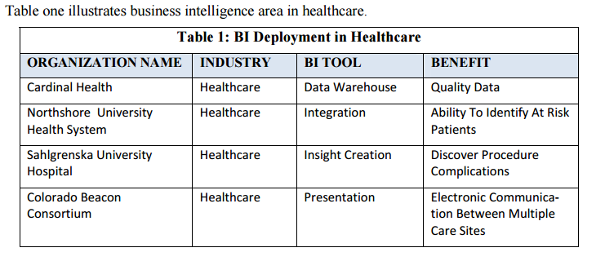
BI Deployment in Healthcare

Slide 15
BI Deployment (Cont.)
The first example from the figure illustrates how organizational memory captured in data warehouse helps provide accurate data.
Business intelligence systems have several advantages, yet these systems are only effective if they have accurate data. Data serves as the foundation for business intelligence, it is therefore essential to enhance the quality of data before embarking on business intelligence solutions.

Slide 16
BI Deployment (Cont.)
The second example from the figure shows how integration capability helps identify patients at risk for disease.
One of the greatest features of business intelligence, affecting health management, is that it has the ability to identify patients at risk for disease.
Allows medical personnel to reduce risk, eliminate unnecessary tests and save patient lives.

Slide 17
BI Deployment (Cont.)
Third example from the figure indicates how insight creation capability helps discover complications from procedures.
Business intelligence solutions also assist medical facilities determine potential complications resulting from procedures.

Slide 18
BI Deployment (Cont.)
The fourth example in the figure is to show how presentation capability of BI helps improve care communication.
Communication is a key area in all industries. End users need to be able to accurately process the information regarding the patient in Healthcare.

Slide 19
Complications of a BI System
Implementing technology into current practice is the biggest complication.
“Researchers from RAND Corporation suggest that the adoption of healthcare technologies could, on the average, save more than $77 billion (Hillestad et al., 2005). Yet despite the savings and efficiency, technology based systems have not been embraced by all healthcare providers.”
The high cost of the initial investment for a BI system deters many smaller practices, however the government mandates (EMR)’s offering incentives and assistance with implementation.

Slide 20
Complications (Cont.)
HIPPA protects patients personal health information.
In order to better protect patients’ personal data, stronger security solutions for technology systems must be developed.
Safeguards need to be implemented to protect from human error issues.

